Slide 1
Migration path from SQL Server Instance on Azure VM (IaaS) towards Azure SQL Managed Instance (PaaS)
Zoran Barac, Data Architect at CIN7

Slide 2




About me
Zoran Barac
Data Architect @ CIN7
MCT, MCSE
zoran.barac.zof@gmail.com
blog.sqlserveronline.com
www.linkedin.com/in/zoran-barac/
www.meetup.com/Auckland-SQL-User-Group/

Slide 3








Explore your PASS community
Own your career with interactive learning built by community and guided by data experts.
Get involved. Get ahead.
Free online webinar events
Local user groups around the world
Connect with the global data community
.org
Online special interest user groups
Learning on-demand and delivered to you
Get involved

Slide 4

Missed PASS Summit 2019?
Get the Recordings
Download all PASS Summit sessions on Data Management, Analytics, or Architecture for only $399 USD
More options available at PASSstuff.com

Slide 5

We are covering all bases to ensure our community can continue reaching new and exciting heights. Plans are underway for the in-person event you all know and love along with a new venture, a new opportunity: a PASS Summit 2020 Virtual Event.
Find out more at PASS.org/summit

Slide 6






Thank you to our Event Sponsors

Slide 7




Thank you to our Global Sponsors

Slide 8

Agenda
Cloud deployment options - Hosted service (PaaS), or a hosted infrastructure (IaaS)
Migration Plan - Target platform selection, Migration tools selection
Purchasing models PaaS - vCore and DTU
What is Azure SQL Database managed instance?
Architectural models that are used in Azure SQL Managed Instance
Migration from IaaS VM SQL Server instance to Azure SQL Managed Instance
Data Migration Assistant (DMA)
Database Experimentation Assistant (DEA)
Database Migration Services (DMS)

Slide 9
Choose the right deployment option - Hosted service (PaaS), or a hosted infrastructure (IaaS)

Slide 10
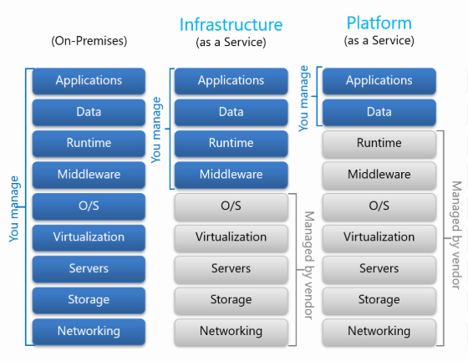
Cloud models: IaaS, PaaS

Slide 11
Migration Plan -Target platform selection, Migration tools selection

Slide 12
Which SQL option should I choose?
Azure SQL Database (PaaS) | SQL Managed Instances (PaaS) | SQL Virtual Machines (IaaS)
PROS: The most commonly used SQL Server features are available. 99.995% availability guaranteed. Built-in backups, patching, recovery. Latest stable Database Engine version. Ability to assign necessary resources (CPU/storage) to individual databases. Built-in intelligence and security. Online change of resources (CPU/storage). CONS: Migration might be hard. Some SQL Server features are not available. Private IPs cannot be assigned (you can limit the access using firewall rules). | PROS: Supports almost all on-premises instance/database level capabilities. High compatibility with SQL Server on-premises. 99.99% availability guaranteed. Built-in backups, patching, recovery. Latest stable Database Engine version. Easy migration from SQL Server. Private IPs within Azure VNet. Online change of resources (CPU/storage). CONS: There is still some minimal number of SQL Server features that are not available. | PROS: You have full control over the SQL Server engine. Supports all on-premises capabilities. Up to 99.99% availability. Full parity with the matching version of on-premises SQL Server. Fixed, well-known database engine version. Easy migration from SQL Server on-premises. CONS: You need to manage your backups and patches. You need to implement your own High-Availability solution. There is a downtime while changing the resources(CPU/storage)

Slide 13
Migration tools selection
 | Single database and elastic pool | Managed Instance and instance pools
SQL Server (on-prem, Azure VM) | Online: Data Migration Service (DMS), Transactional Replication Offline: BACPAC file (import), BCP | Online: Data Migration Service (DMS), Transactional Replication Offline: Native backup/restore, BACPAC file (import), BCP, Snapshot replication
Single database | Offline: BACPAC file (import), BCP | Offline: BACPAC file (import), BCP
Azure SQL Managed Instances | Online: Transactional Replication Offline: BACPAC file (import), BCP, Snapshot replication | Online: Transactional Replication Offline: Cross-instance point-in-time restore (Azure PowerShell or Azure CLI), Native backup/restore, BACPAC file (import), BCP, Snapshot replication

Slide 14
Purchasing models PaaS - vCore and DTU

Slide 15
vCore and DTU purchasing models
Different purchasing models are available for different Azure SQL Database deployment models:
The single database and elastic pool deployment options in Azure SQL Database offer both the DTU-based purchasing model and the vCore-based purchasing model.
The managed instance deployment option in Azure SQL Database offers only the vCore-based purchasing model.
The Hyperscale service tier is available for single databases that are using the vCore-based purchasing model.

Slide 16
vCore model and service tiers options
Main caracteristics of vCore model
Higher compute, memory, IO, and storage limits.
Control over the hardware generation to better match compute and memory requirements of the workload.
Pricing discounts for Azure Hybrid Benefit (AHB) and Reserved Instance (RI).
Greater transparency in the hardware details that power the compute;
Service tiers
Service tier options in the vCore model include General Purpose, Business Critical, and Hyperscale. The service tier generally defines the storage architecture, space and IO limits, and business continuity options related to availability and disaster recovery.

Slide 17
What is Azure SQL Database managed instance?

Slide 18
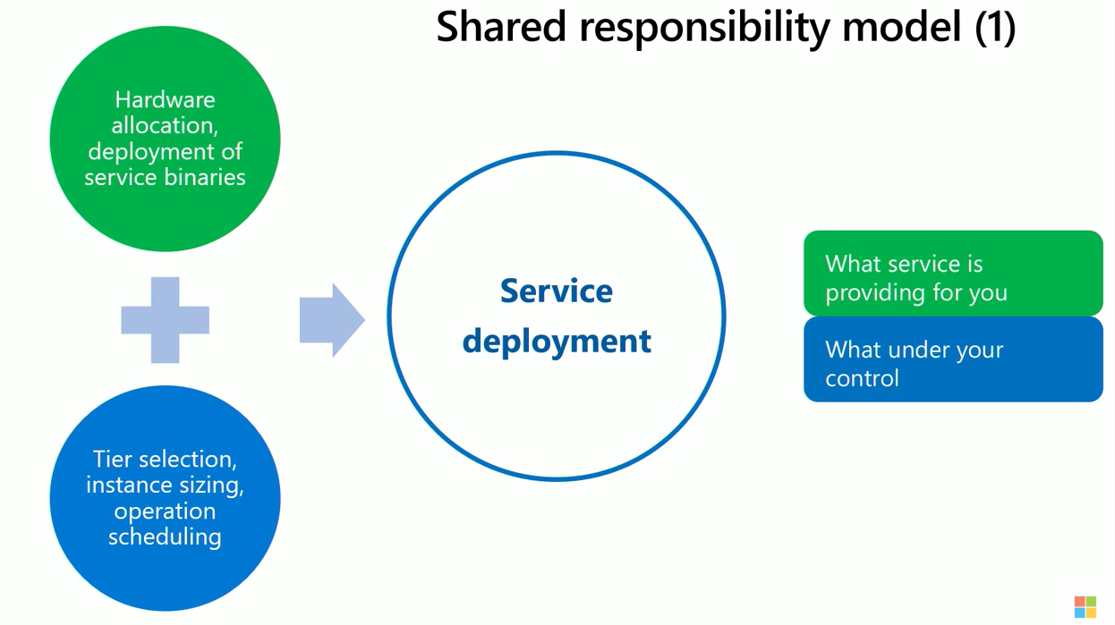
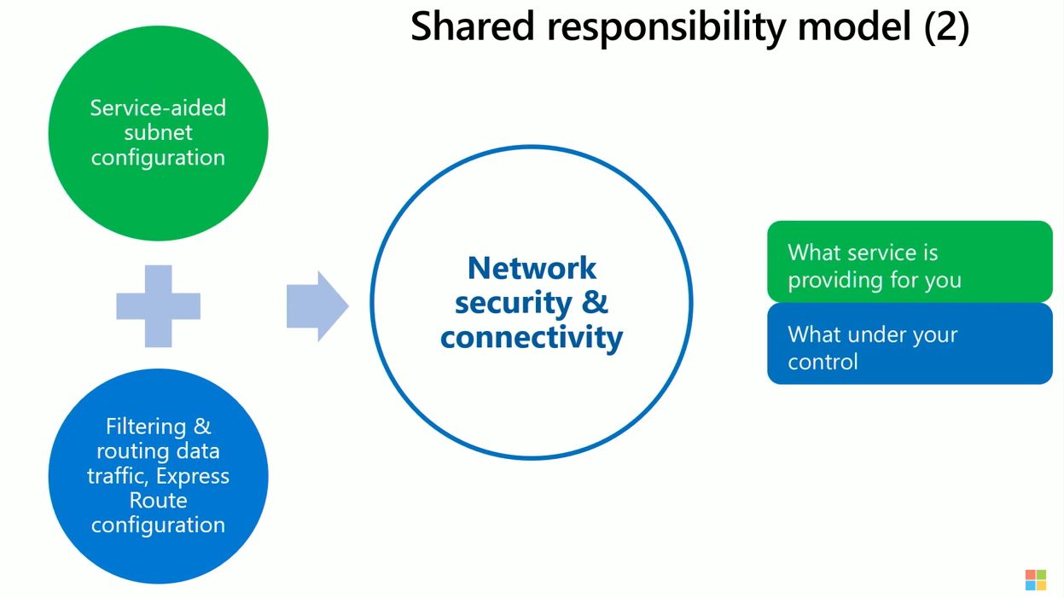
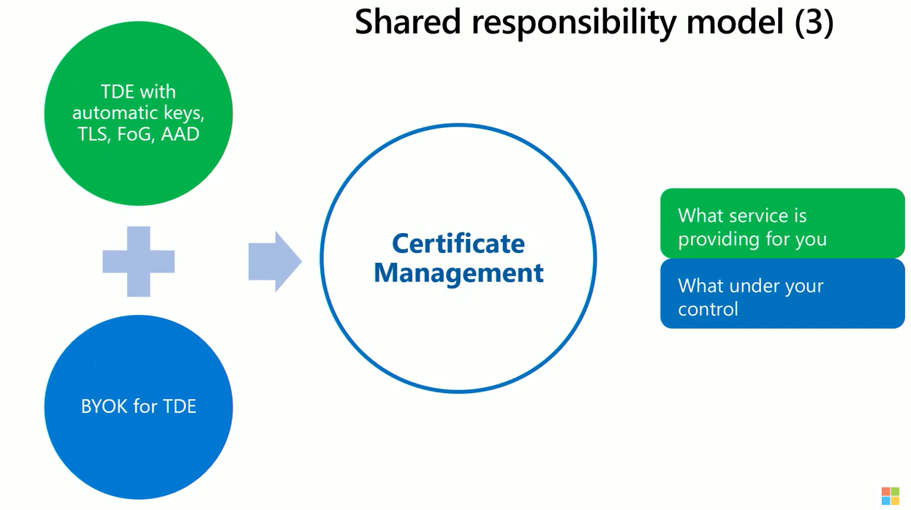
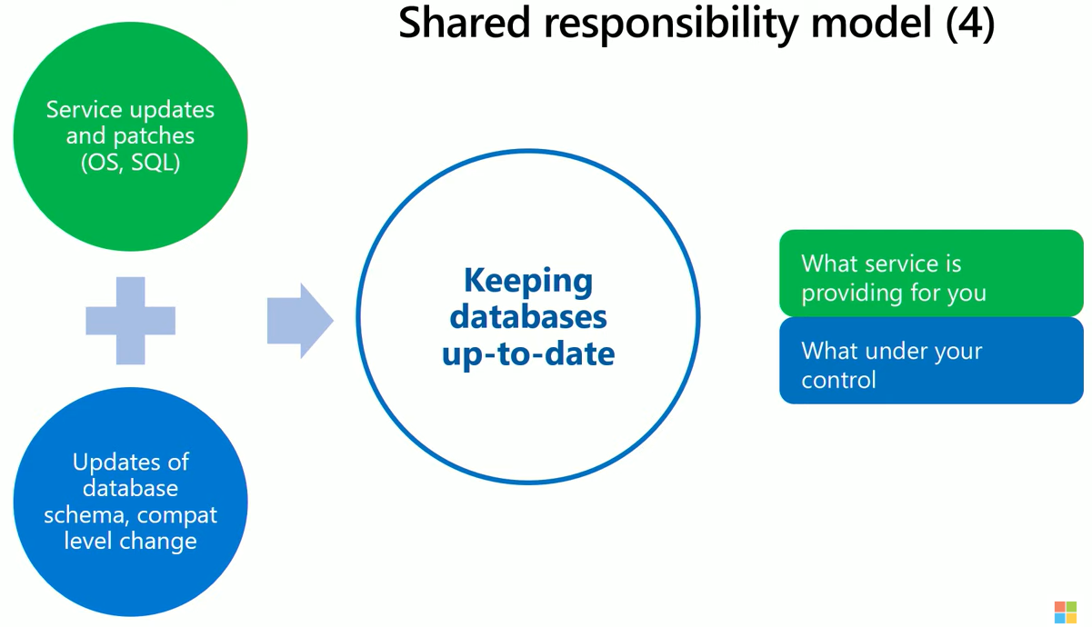

Slide 19
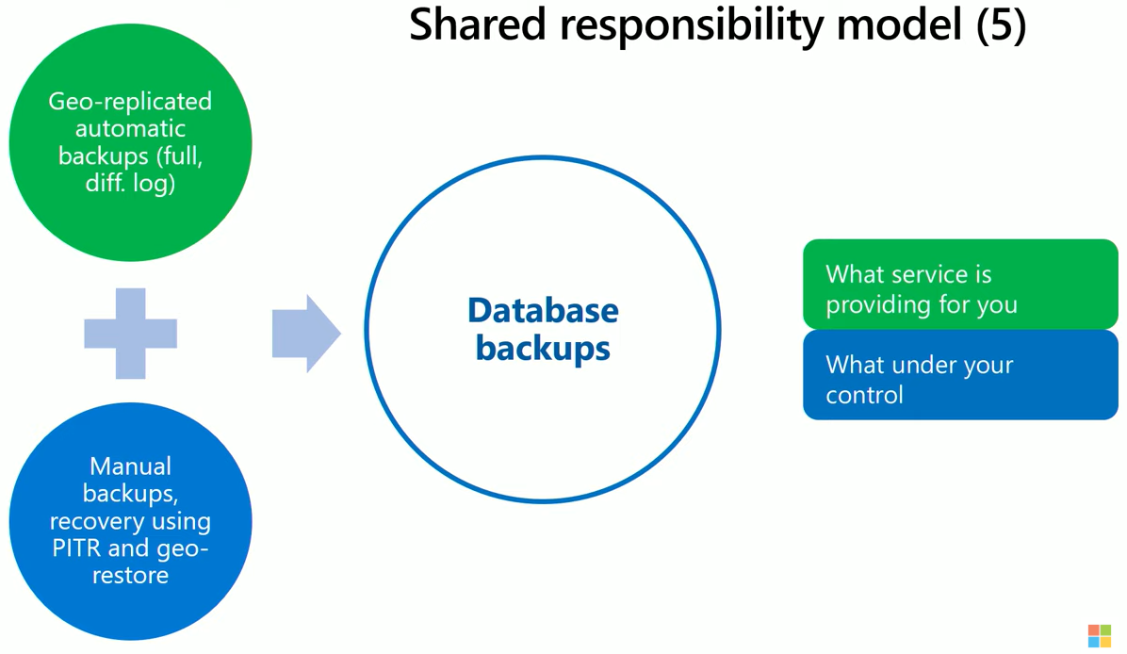
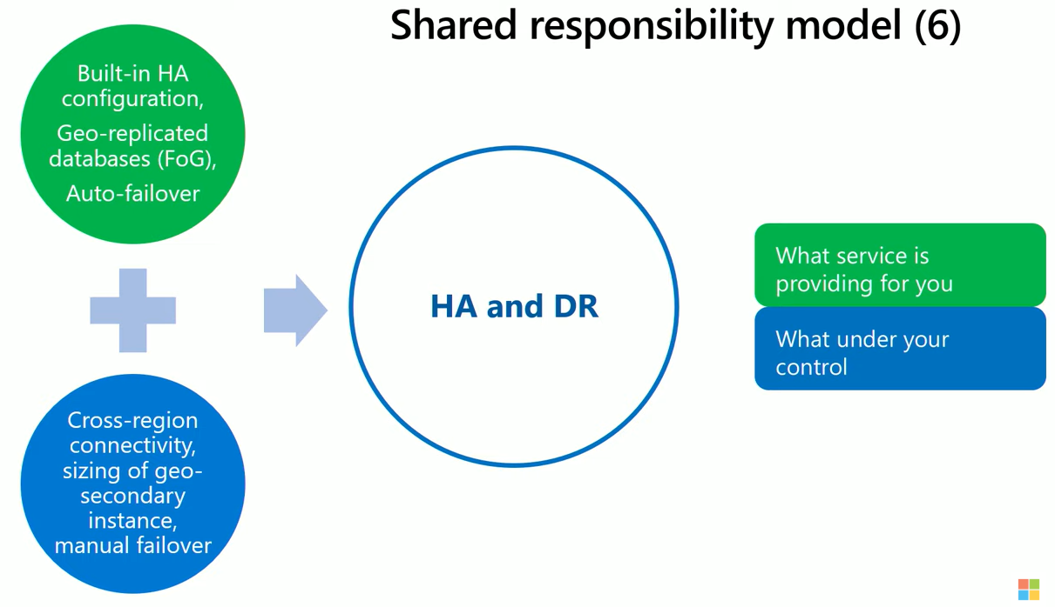
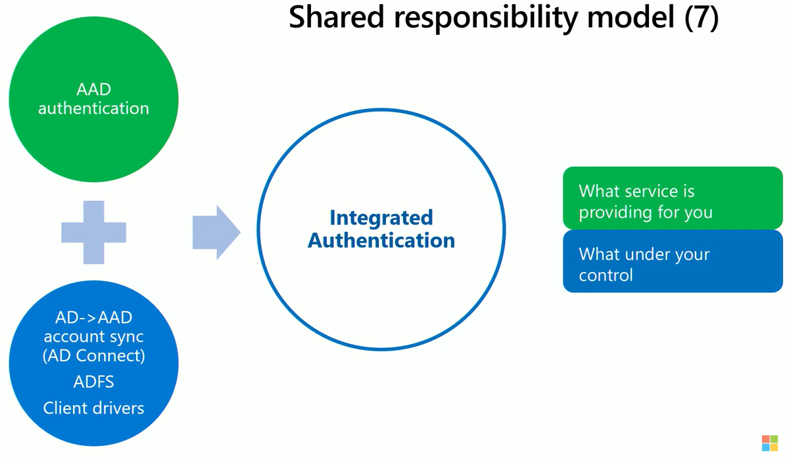

Slide 20
Architectural models that are used in Azure SQL Managed Instance

Slide 21
Architectural models that are used in Azure SQL Managed Instance
Standard availability model that is based on a separation of compute and storage. It relies on high availability and reliability of the remote storage tier. This architecture targets budget-oriented business applications that can tolerate some performance degradation during maintenance activities.
Premium availability model that is based on a cluster of database engine processes. It relies on the fact that there is always a quorum of available database engine nodes. This architecture targets mission critical applications with high IO performance, high transaction rate and guarantees minimal performance impact to your workload during maintenance activities.

Slide 22
Service tier characteristics
 | General Purpose | Business Critical
Number of vCores* | Gen4: 8, 16, 24 Gen5: 4, 8, 16, 24, 32, 40, 64, 80 | Gen4: 8, 16, 24 Gen5: 4, 8, 16, 24, 32, 40, 64, 80
Max memory | Gen4: 56 GB - 168 GB (7GB/vCore) Gen5: 20.4 GB - 408 GB (5.1GB/vCore) Add more vCores to get more memory. | Gen4: 56 GB - 168 GB (7GB/vCore) Gen5: 20.4 GB - 408 GB (5.1GB/vCore) for read-write queries + additional 20.4 GB - 408 GB (5.1GB/vCore) for read-only queries.
Max instance storage size (reserved) | - 2 TB for 4 vCores (Gen5 only) - 8 TB for other sizes | Gen4: 1 TB Gen5: 1 TB for 4, 8, 16 vCores / 2 TB for 24 vCores / 4 TB for 32, 40, 64, 80 vCores
Max tempDB size | Limited to 24 GB/vCore (96 - 1,920 GB) | Up to currently available instance storage size.
Data/Log IOPS (approximate) | Up to 30-40 K IOPS per instance*, 500 - 7500 per file | 10 K - 200 K (2500 IOPS/vCore) Add more vCores to get better IO performance.
Log write throughput limit (per instance) | 3 MB/s per vCore Max 22 MB/s | 4 MB/s per vCore Max 48 MB/s
Data throughput (approximate) | 100 - 250 MB/s per file | Not limited.
Storage IO latency (approximate) | 5-10 ms | 1-2 ms
In-memory OLTP | Not supported | Available, size depends on number of vCore
Read-only replicas | 0 | 1 (included in price)

Slide 23
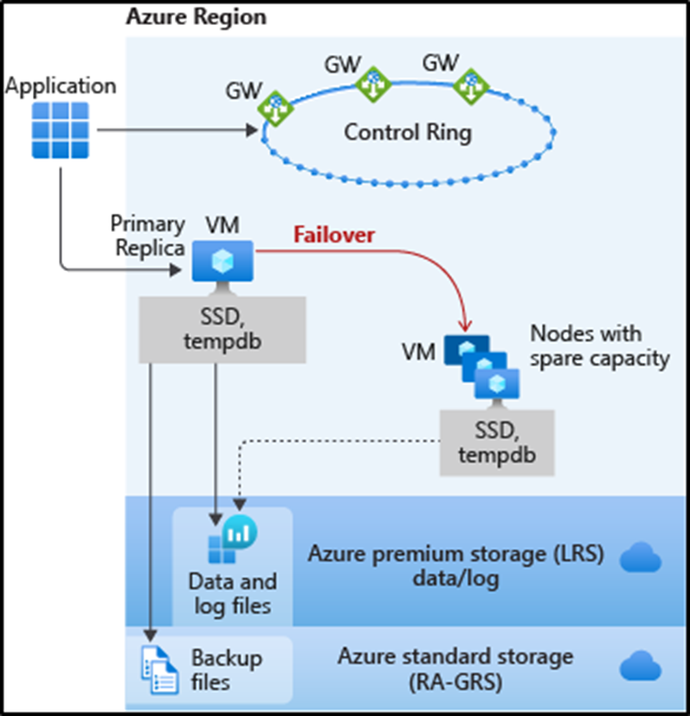
General Purpose service tier availability
The standard availability model includes two layers:
Compute layer that runs the sqlserver.exe process (contains only transient and cached data on the attached SSD, such as TempDB, model database, plan cache, buffer pool ).
Data layer with the database files (.mdf/.ldf) that are stored in Azure Blob storage. Azure blob storage has built-in data availability and redundancy feature.

Slide 24
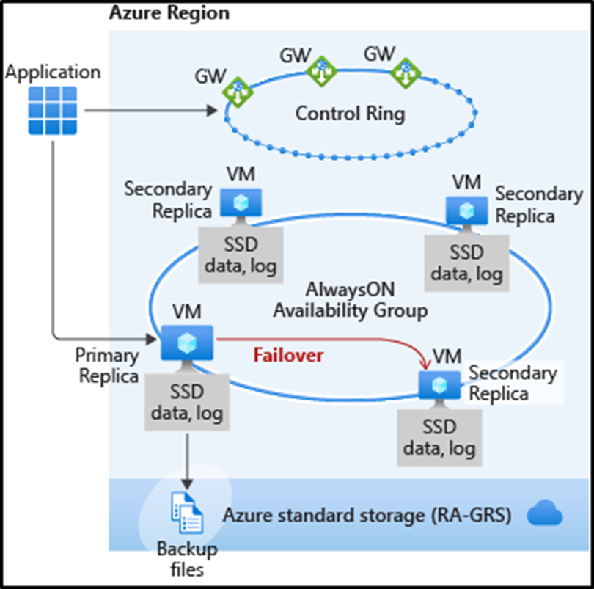
Business Critical service tier availability
Business Critical service tiers leverage the Premium availability model, which integrates compute resources (SQL Server Database Engine process) and storage (locally attached SSD) on a single node.
High availability is achieved by replicating both compute and storage to additional nodes creating a three to four-node cluster.

Slide 25
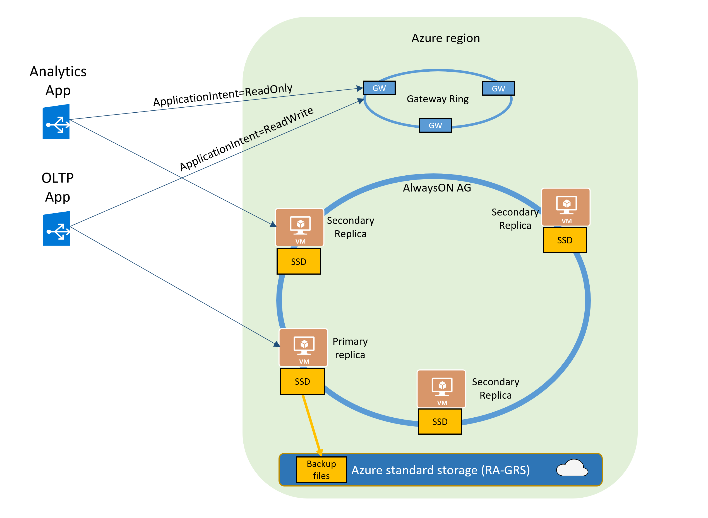
Read-only replicas and read-only query workloads
The Read Scale-Out feature is enabled by default on new Premium, Business Critical, and Hyperscale databases.
In case of Azure SQL Managed Instance it will be Business Critical service tier.
If your SQL connection string is configured with ApplicationIntent=ReadOnly, the application will be redirected by the gateway to a read-only replica of that database.

Slide 26
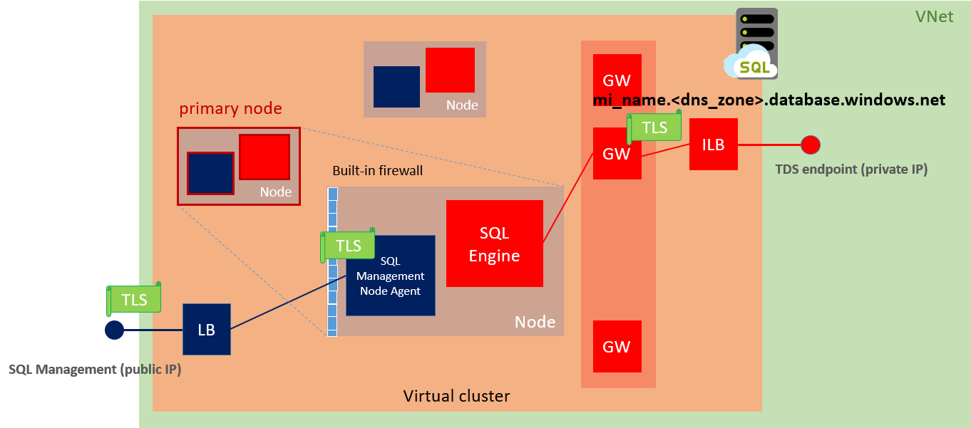
Virtual cluster connectivity architecture

Slide 27
Migration from IaaS VM SQL Server instance to Azure SQL Managed Instance

Slide 28
Database migration from IaaS VM SQL Server instance to Azure SQL MI
Step 1. Data Migration Assistant (DMA)
First step will be to determine whether Azure SQL Managed Instance is compatible with the database requirements of business application.
Step 2. Database Experimentation Assistant (DEA)
Database Experimentation Assistant (DEA) is an experimentation solution for SQL Server upgrades. The DEA tool helps to evaluate the effects on database performance, of database migration between different SQL Server instances.
Step 3. Database Migration Service (DMS)
Azure Database Migration Service is designed as a seamless, end-to-end solution for moving on-premises SQL Server databases to the cloud.

Slide 29
Data Migration Assistant (DMA)

Slide 30
Data Migration Assistant (DMA)
Using Data Migration Assistant (DMA) tool we can detect potential compatibility issues which may impact our database functionality after migration to Azure SQL managed Instance.
DMA main functionalities:
Discover issues that can affect an upgrade to an on-premises SQL Server
Discover new features in the target SQL Server platform
Migrate an on-premises SQL Server instance to a modern SQL Server instance

Slide 31
Data Migration Assistant (DMA) - Assessment
Assess on-premises SQL Server instance(s) migrating to Azure SQL database(s).
The assessment workflow helps you to detect the following issues that can affect migration and provides detailed guidance on how to resolve them.
Migration blocking issues: Discovers the compatibility issues that block migrating on-premises SQL Server database(s) to Azure SQL Database(s).
Partially supported or unsupported features: Detects partially supported or unsupported features that are currently in use on the source SQL Server instance. DMA provides a comprehensive set of recommendations, alternative approaches available in Azure, and mitigating steps so that you can incorporate them into your migration projects.

Slide 32
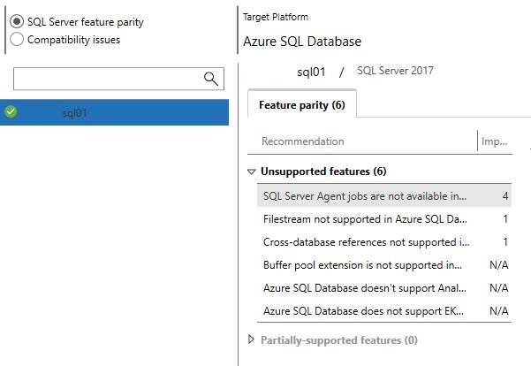
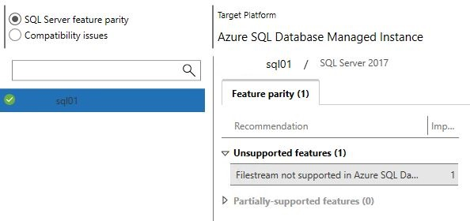
DMA / Instance Level – Azure SQL Database / Azure SQL MI
Azure SQL Database | Azure SQL Managed Instance

Slide 33
SQL Server feature parity – unsupported features example
Azure SQL Database
Buffer pool extension is not supported in Azure SQL Database
Azure SQL Database doesn’t support Analysis Services; migrate to Azure Analysis Services
Cross-database references not supported in Azure SQL Database
Filestream not supported in Azure SQL Database
SQL Server Agent jobs not available in Azure SQL Database
Azure SQL Managed Instance
Filestream not supported in Azure SQL Database

Slide 34
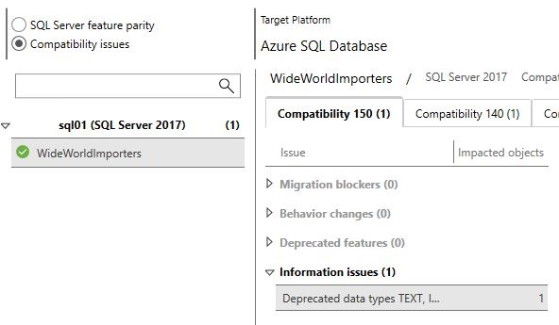
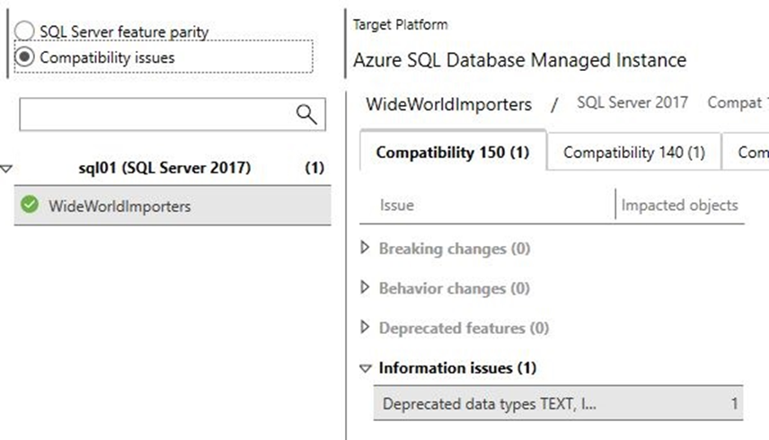
DMA / DB Level – Azure SQL Database / Azure SQL MI
Azure SQL Database | Azure SQL Managed Instance

Slide 35
Data Migration Assistant (DMA)
Step by step

Slide 36
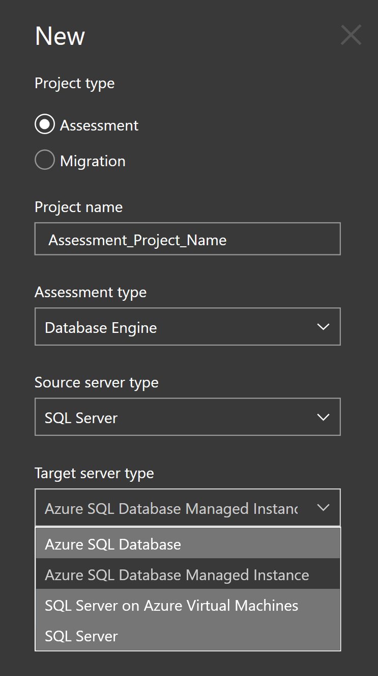
DMA 01
Run the DMA tool and create new project.
Although you can use DMA for schema and data migration as well I wouldn’t recommend this tool for the big databases migration, just for the assessment.
Choose the project type (Assessment), source and target server type. In this example I used SQL Server as a source and Azure SQL Managed Instance as a target server type.

Slide 37
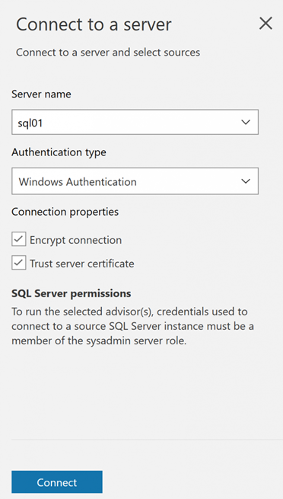
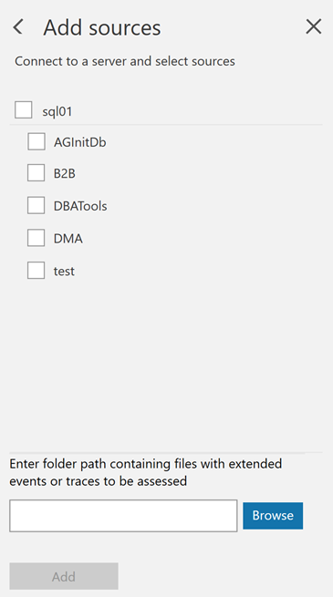
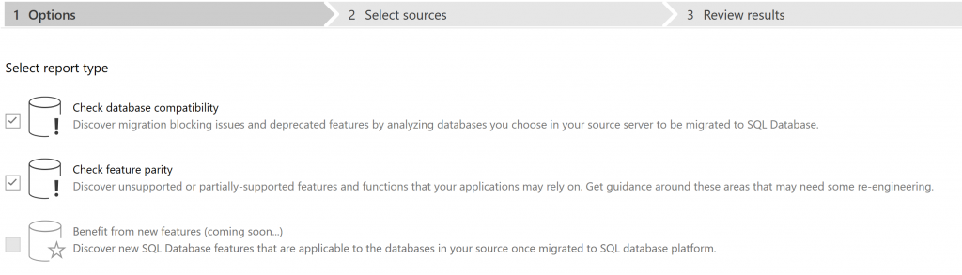
DMA 02
Next step is to select report type. In this example we will check possible compatibility issues that may block our migrating to the cloud. DMA as well provides recommendations to help you address those issues. | Connect to the server and select source databases

Slide 38
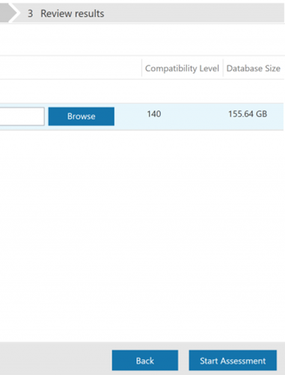
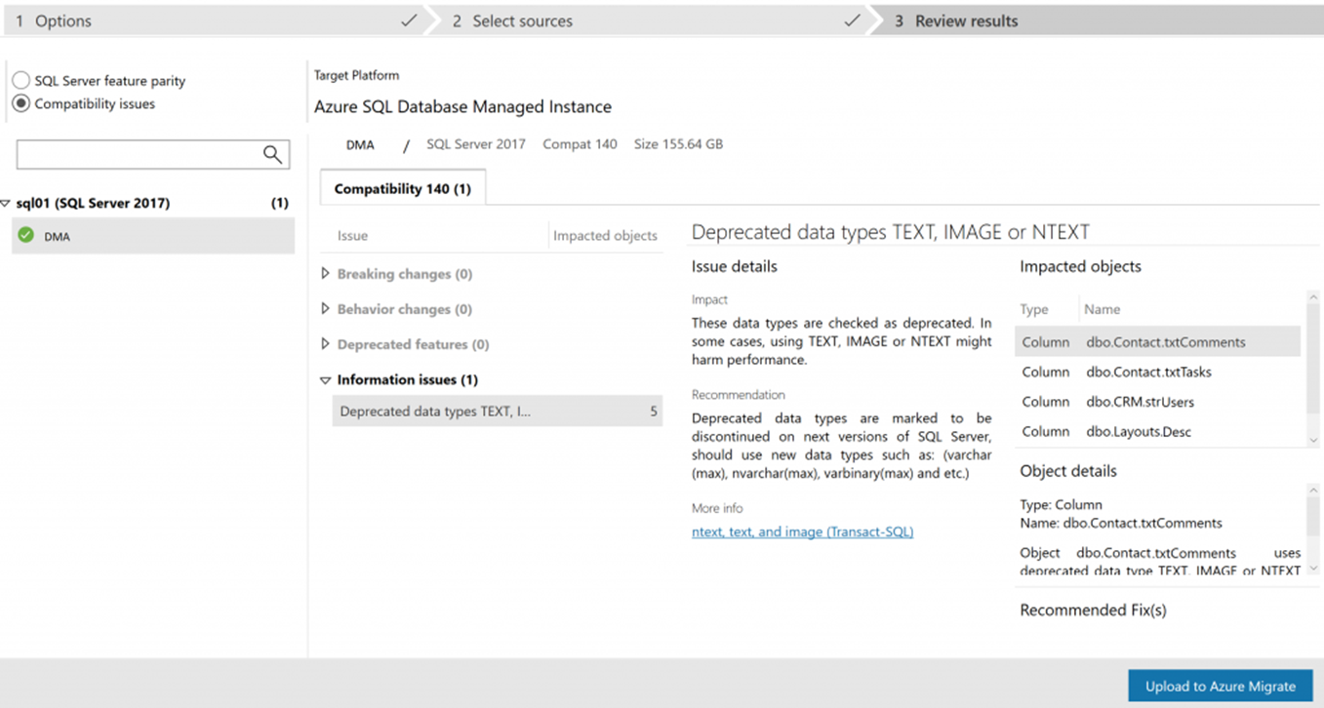
DMA 03
Start assessment | As you can see from the picture bellow possible compatibility issues may be: Breaking changes, Behavior changes, Deprecated features

Slide 39
Database Experimentation Assistant (DEA)

Slide 40
Database Experimentation Assistant (DEA)
Database Experimentation Assistant (DEA) is an experimentation solution for SQL Server upgrades. DEA can help you evaluate a targeted version of SQL Server for a specific workload.
DEA analysis metrics include:
• Queries that have compatibility errors.
• Degraded queries and query plans.
• Other workload comparison data.
Comparison data can lead to higher confidence and help ensure a successful upgrade and migration experience.

Slide 41


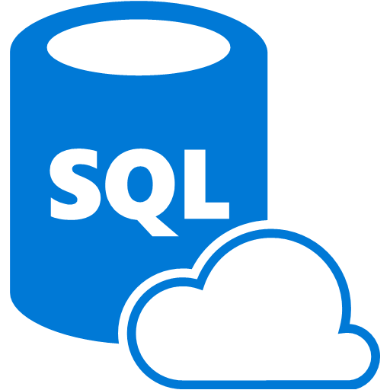

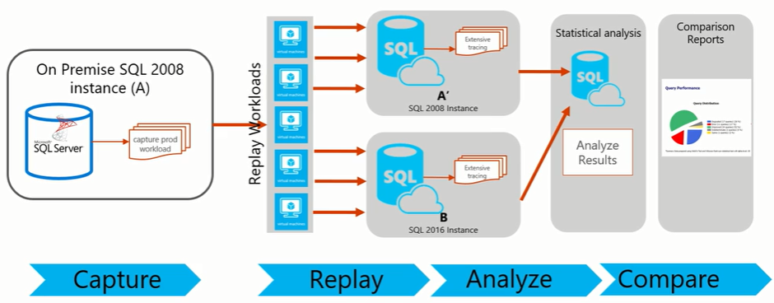
DEA – Architecture (InBuilt Replay Tool and XEvents)
Azure VM
DEA V2.6
SQL 2017
SSAS
Azure VM SQL Server 2017
Instance
Azure SQL Managed Instance
DEA Analysis Reports
Capture production workload (XE trace)
Replay production workload (XE trace)

Slide 42
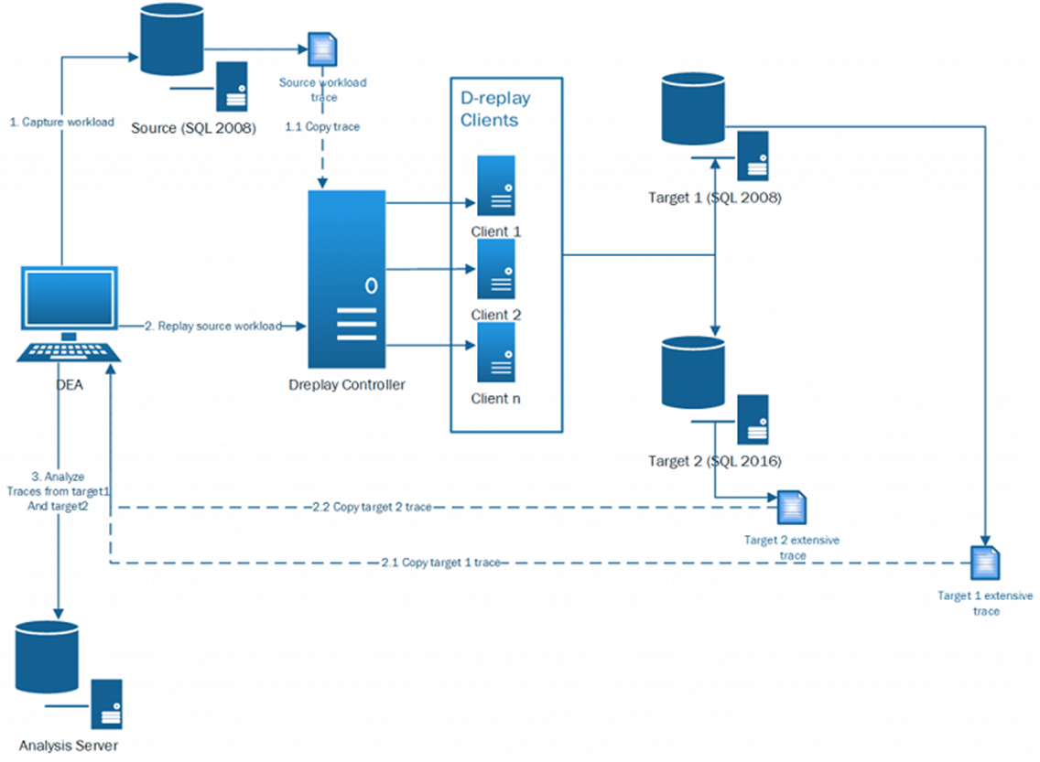
DEA – Architecture (DReplay Replay Tool and Trace)

Slide 43
Database Experimentation Assistant (DEA) step by step

Slide 44
Database Experimentation Assistant (DEA)
Using Database Experimentation Assistant (DEA) you can evaluate your current production workload from your current environment and analyze how will that workload perform in your new targeted environment.
For this example we are going to use following:
Source: SQL Server 2017, 32CPU, 256GB Memory
Target: Azure SQL Managed Instance, BC Gen5 (16 vCores, 80GB Memory)
DEA VM: SQL Server 2017, 4CPU, 32GB Memory
Workload: 10minutes XE trace (XEL), size 19.9GB

Slide 45
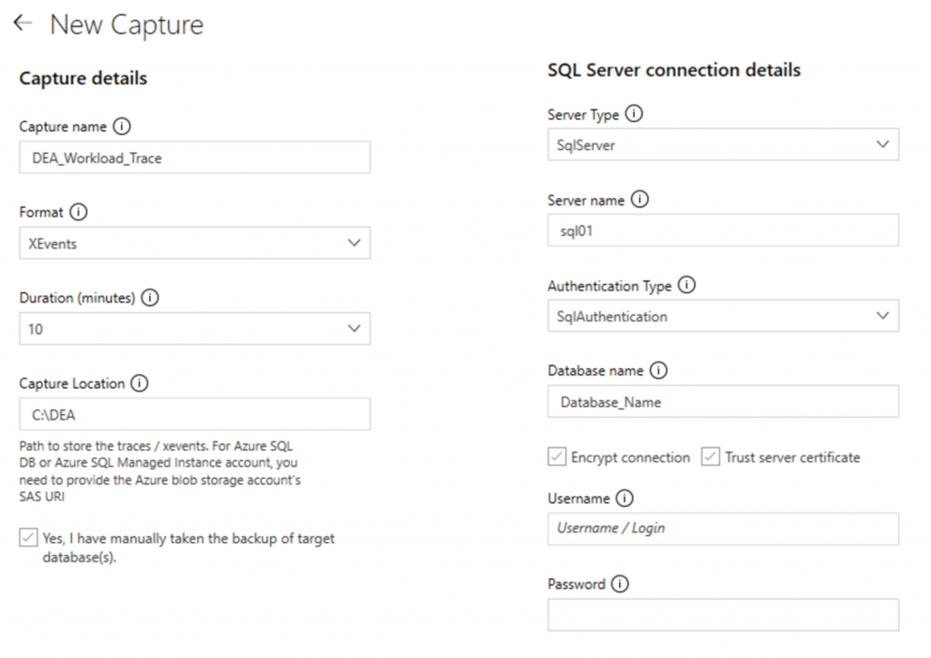
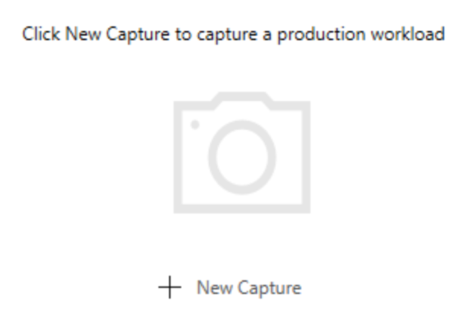
DEA 01
First step will be capturing the workload (Extended Event trace) from the source SQL server. Open DEA and select Capture Traces option | For this example I choose Extended Events trace option. Capture Location is a valid folder path on the SQL Server source machine where server side Extended Events XEL files can be stored. Make sure SQL Server account has write permissions on the folder specified. If you are using Azure SQL Managed Instance or Azure SQL Database as a source server you need to provide blob storage account as a Capture Location.

Slide 46
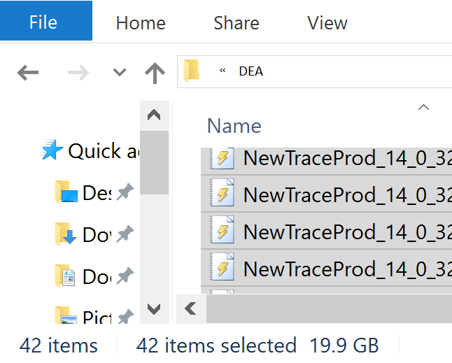
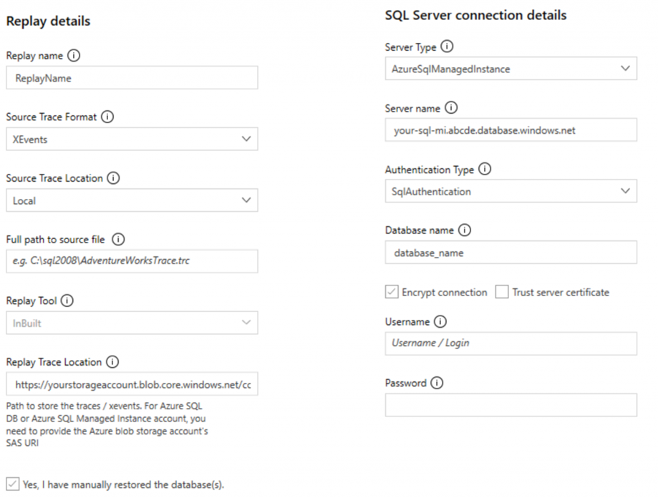
DEA 02
For this example I captured 10 minutes trace from production server. Exactly 42 files, size 19.9 GB (That depends on the traffic at the time) | Next step will be replaying the captured workload trace against your target environment. Source Trace Location will be location of your captured XE XEL files. Replay Trace Location will be blob storage account (URL + Shared Access Signature) since we are using Azure SQL Managed Instance as our targeted instance.

Slide 47
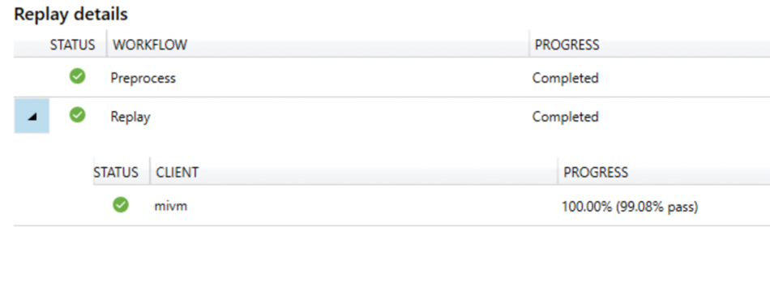
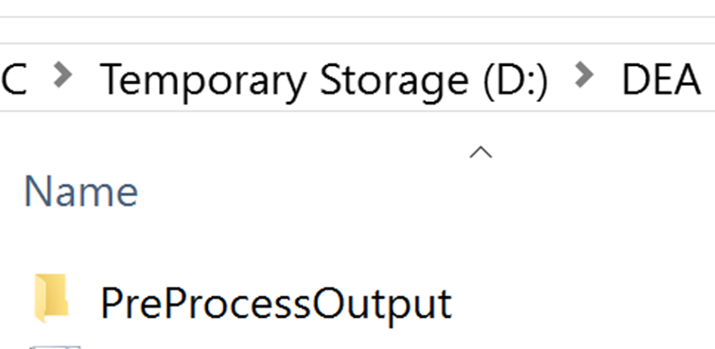
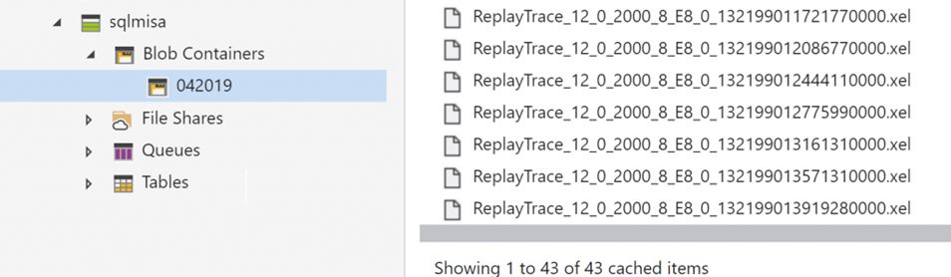
DEA 03
After you run replay, DEA tool will create a new sub folder within your Source Trace Location named PreProcessOutput, all Replay Markup Language (RML) files will be stored there. | After replay is completed you should have your XE XEL files in specified Replay Trace Location (Blob Storage Account)

Slide 48
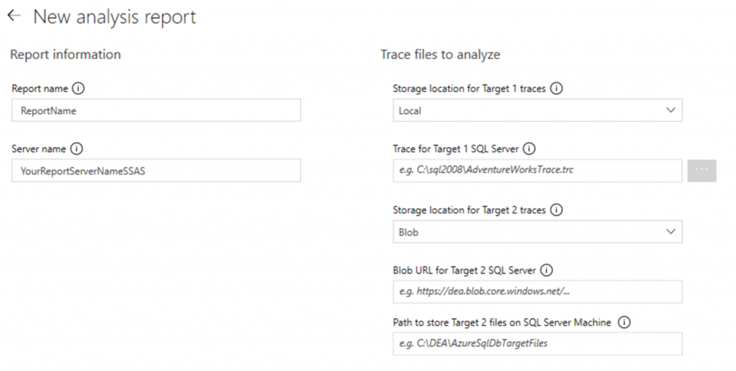
DEA 04
Next step will be analyzing the replayed collected workload traces. With DEA you can generate an analysis report which will help you understand what will be performance impact after migration. DEA analyze your workload and provides performance details for each query run on both Source SQL Server and target Azure SQL Managed Instance. | Trace for Target 1 SQL Server is actually path to the source server trace location. BLOB URL for Target 2 SQL Server is BLOB URL used when you replayed the workload trace against your target Server (Azure SQL managed Instance). Path to store Target 2 files on SQL Server Machine is location where DEA is going to copy files from the URL BLOB storage, so DEA can analyze those workload traces.

Slide 49
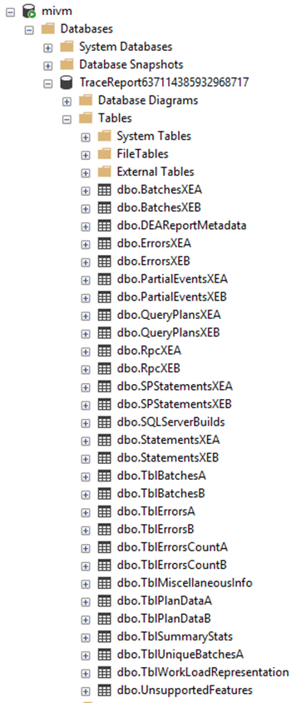
DEA 05
After providing all necessary information DEA will generate an analysis report using the replay traces and at the end will give you insights into your workload performance impact after migration. As well, DEA will create DB on your local SQL Instance (DEA VM).

Slide 50
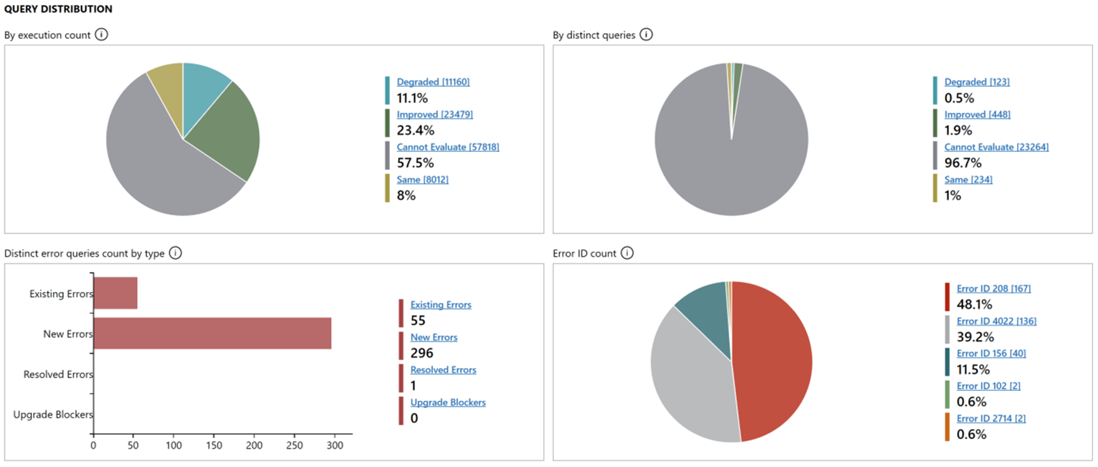
DEA Analysis Report example with the insights into your workload performance impact.

Slide 51
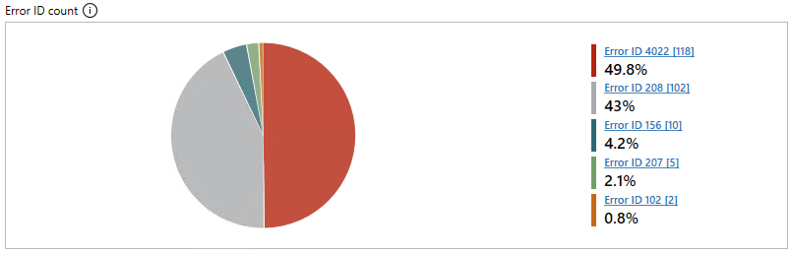
DEA Analysis Report example – Error ID Count report
Those are expected errors, we have queries creating temp tables, those temp tables do not exist on the target instance at time of workload execution.
Error ID 4022 - Bulk load was expected but not sent. The batch will be terminated.
Error ID 208 - Invalid object name.
Error ID 207 - Invalid column name.

Slide 52
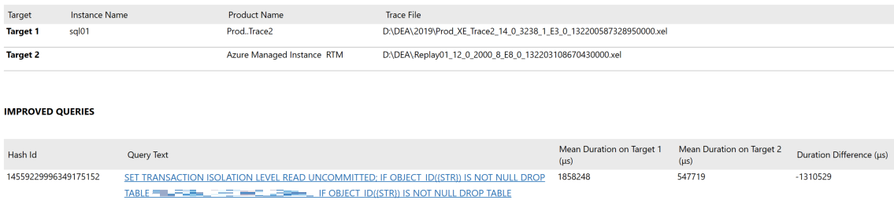
You can select improved queries by execution count from query distribution list to see more detailed information about specific queries.

Slide 53
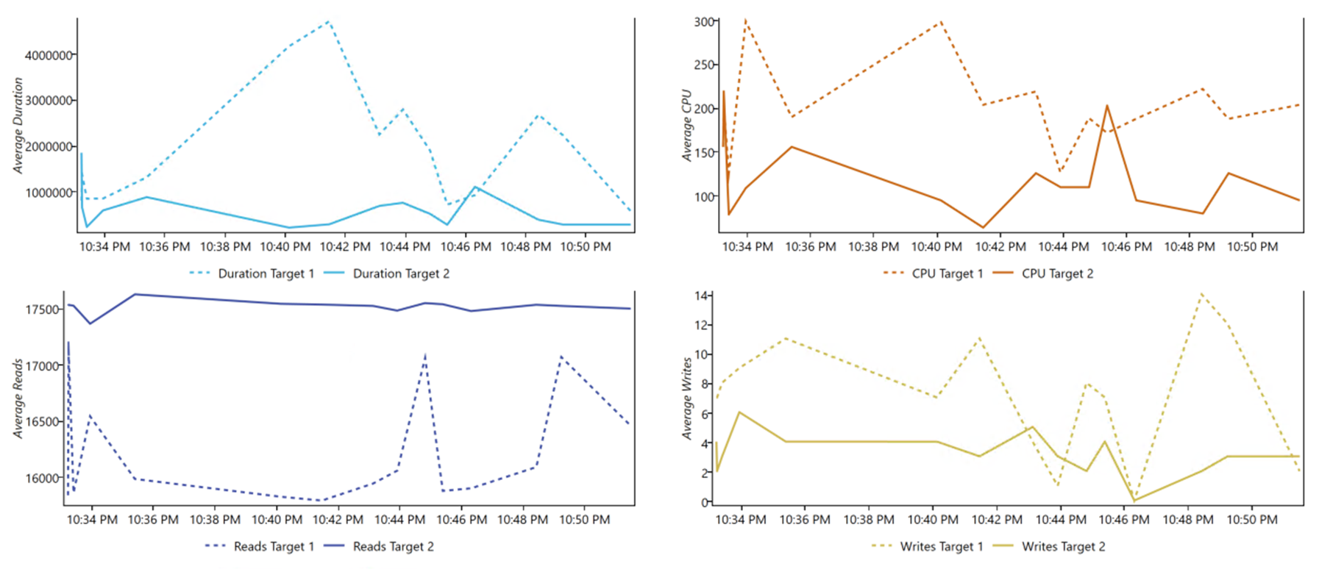
You can select specific query for more detailed information

Slide 54
Database Migration Services (DMS)

Slide 55
Database Migration Services (DMS)
Azure Database Migration Service is a fully managed service designed to enable seamless migrations from multiple database sources to Azure data platforms with minimal downtime (online migrations).
Azure Database Migration Service integrates some of the functionality of our existing tools and services. The service uses the Data Migration Assistant to generate assessment reports that provide recommendations to guide you through the changes required before performing a migration.

Slide 56
Database Migration Services (DMS)
Step by step

Slide 57
Database Migration Services (DMS)
For this example we are going to use following:
Azure Database Migration Service (DMS), Premium tier (4 vCores)
DMS Project: Online Data Migration
Source: SQL Server 2017, 8CPU, 64GB Memory
Target: Azure SQL Managed Instance, 16 vCores, 80GB Memory

Slide 58
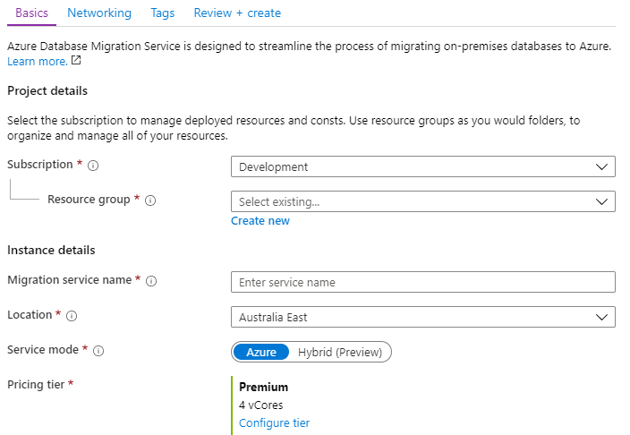
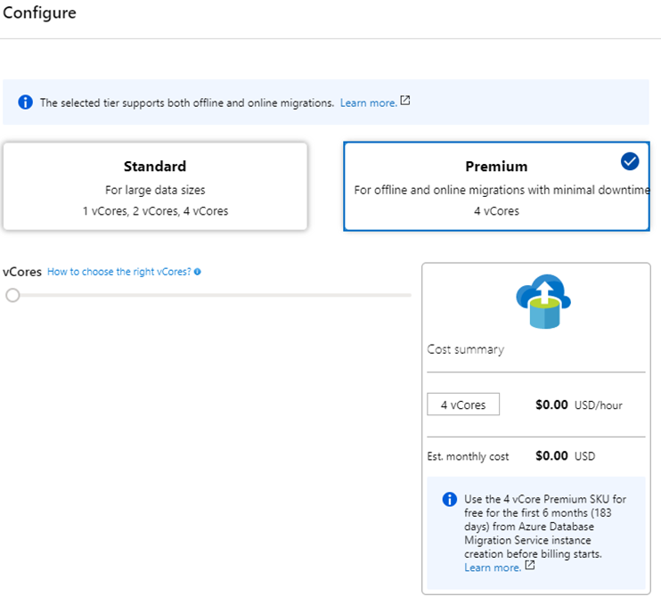
DMS 01
First step we will be to deploy Database Migration Service. Specify a name for the database migration service, and choose/create your resource group. | Configure your pricing tier. For this “Online type” of migration example I will use “Premium” pricing tier.

Slide 59
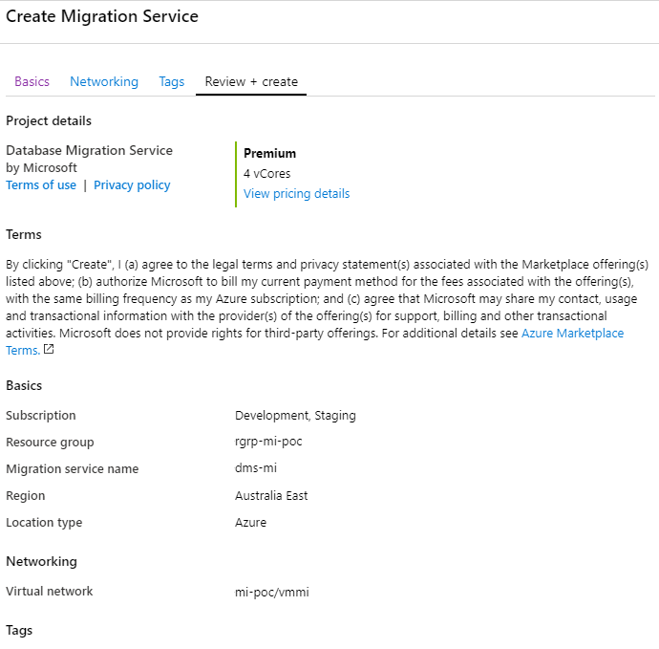
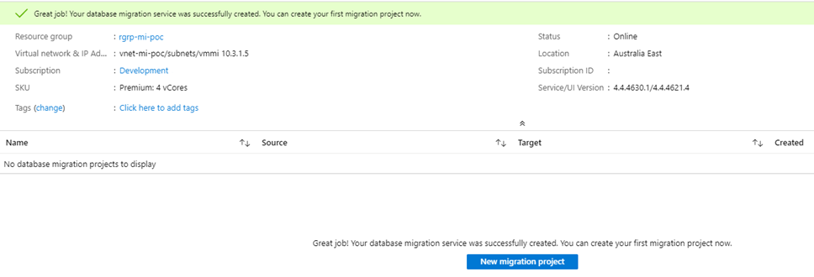
DMS 02
Select/create VNet. For this example I will the use the same VNet we used for our SQL Managed Instance (Target Server). Review and create Migration Service. | Once our service is deployed and online we can create our migration project.

Slide 60
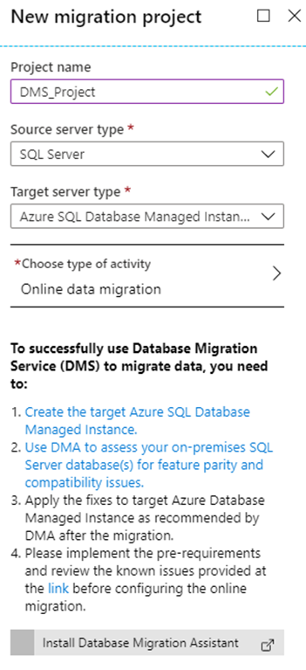
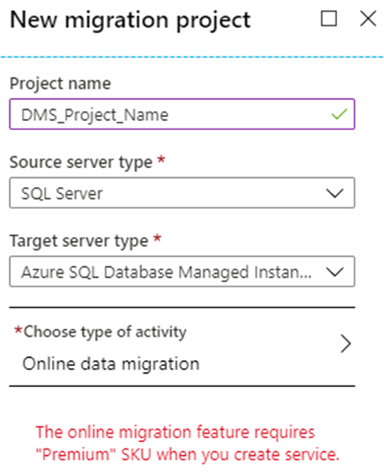
DMS 03
Choose project name, source server type, target server type and type of activity. | The reason why we choose premium pricing tier for our DMS was that the online migration feature requires “Premium” SKU DMS.

Slide 61
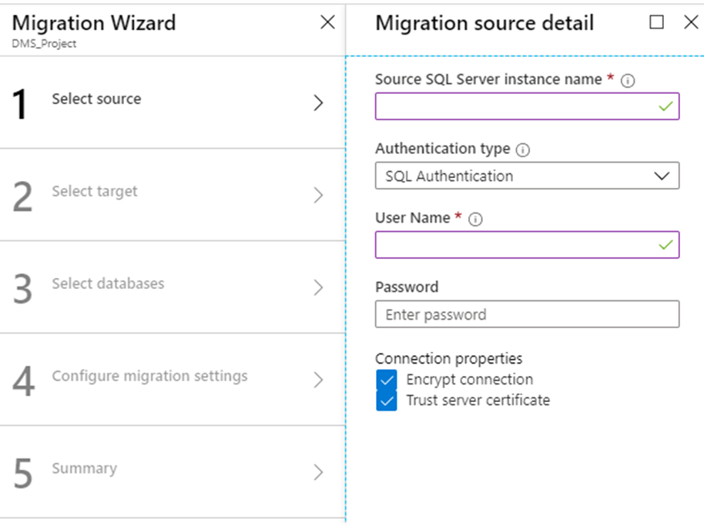
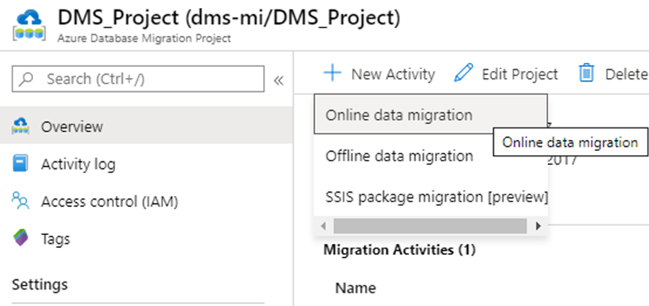
DMS 04
Once we have our Azure Database Migration Project we need to create new “Online data migration” activity. | Specify source details, connection details for the source SQL Server.

Slide 62
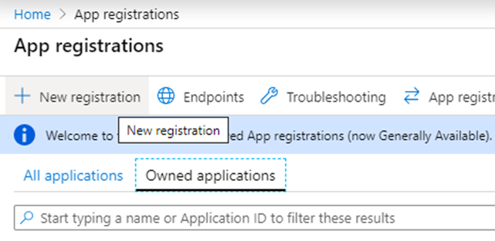
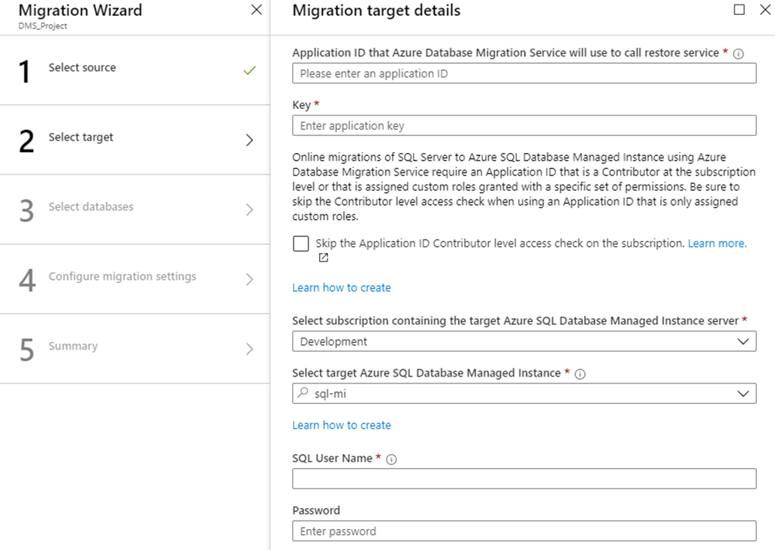
DMS 05
Specify target details, connection details for the target Azure SQL MI. You will need application ID that Azure Database Migration Service will use to call restore service. DMS uses the “application ID” to access the target Azure SQL Database Managed Instance resource and Azure Storage Account to perform online migrations. | To get application ID you need to use App registrations page and create new app registration.

Slide 63
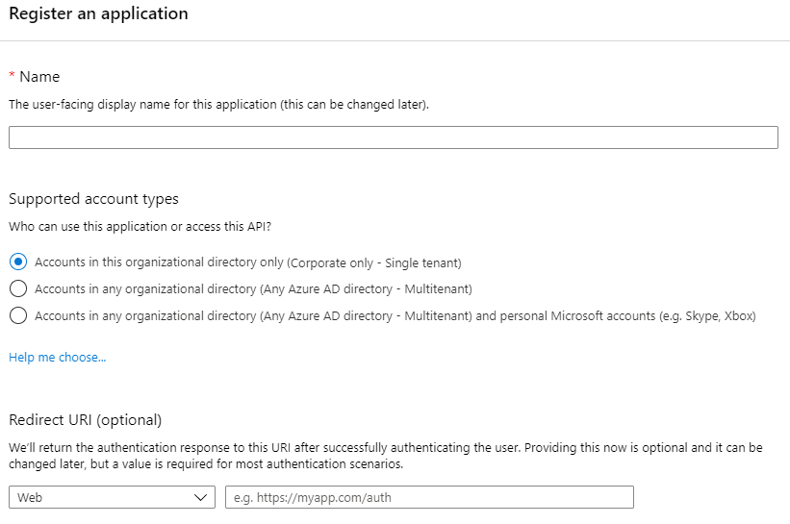
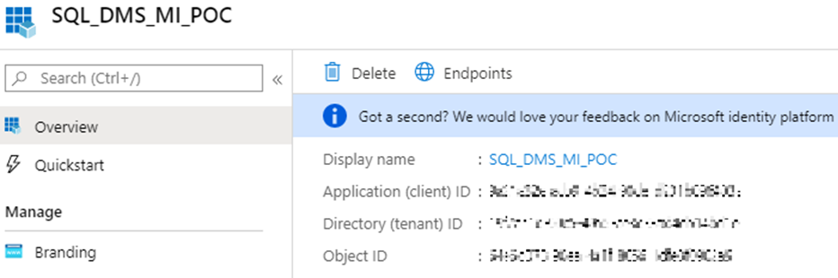
DMS 06
Register an application. | Once you have your app registered you should have Application ID

Slide 64


DMS 07
Next step is to select “Certificates & Secrets” and create new client secret. Client secret is a secret string that application uses to prove its identity when requesting a token. Also can be referred to as application password. You will use this as application key during migration target details configuration. | After you successfully connected to your target Azure SQL Managed Instance you can select source database you want to migrate.

Slide 65


DMS 08
Choose network share location. Network share can be location on you source SQL Server. Make sure you use domain account which has read permissions on the network share location. Then select subscription containing storage account that allows Azure Database Migration Service to upload database backup files to, and use those files for migration database to our targeted Azure SQL MI. | Once we have all that, we can run our newly created project migration activity.

Slide 66

DMS Project Activity
Note.
Azure Database Migration Service only supports backups created using checksum.

Slide 67

Session Evaluations
Q & A
https://www.surveymonkey.com/r/H87C3Q9

Slide 68
Resources
https://blog.sqlserveronline.com/2019/10/30/azure-sql-managed-instances-migration-data-migration-assistant-dma-assess-on-premises-sql-server-instance/
https://blog.sqlserveronline.com/2019/11/11/azure-sql-managed-instances-migration-database-experimentation-assistant-dea-evaluate-your-workload-before-you-migrate-your-database-to-azure-sql-managed-instance/
https://blog.sqlserveronline.com/2019/12/23/azure-sql-managed-instance-database-migration-service-dms-online-data-migration-migrate-your-database-to-azure-sql-managed-instance/
https://docs.microsoft.com/en-us/sql/dma/dma-overview?view=sql-server-ver15
https://docs.microsoft.com/en-us/sql/dea/database-experimentation-assistant-overview?view=sql-server-ver15
https://docs.microsoft.com/en-us/azure/dms/
https://datamigration.microsoft.com/scenario/sql-to-azuresqldbmi?step=1
https://docs.microsoft.com/en-us/azure/sql-database/sql-database-managed-instance-resource-limits
https://docs.microsoft.com/en-us/azure/sql-database/sql-database-features
https://docs.microsoft.com/en-us/azure/sql-database/sql-database-paas-vs-sql-server-iaas

Slide 70
Thank you to our Event Sponsors

Slide 71


Thank You to our Global SQLSaturday Sponsors

